Slide 1

E-MEDICARE
E-MEDICARE
get medicine at your doorstep
Group-6

Slide 2
Team
Arram Srija – 2569151
Gangineni Sowmya - 2567363
Paidakula Sai Charan - 2569278
Piyush Garg - 2567663
Prasanna Hiremath – 2569164
Shivukumar Babaladi - 2567740
Sushmitha B S - 2569246
Vineet Kumar - 2567576

Slide 3
Contents
Introduction
Tools used
Features
Modules
Advantages
Conclusion

Slide 4
Introduction
E-Medicare is an online medical store.
It helps the customer to purchase medicine through the website.
Customer can find various types of medicine and buy the medicine at a reasonable price.
E-Medicare is a web application that supplies medicines and other health care products.

Slide 5
Technologies Used
Spring Boot
My SQL
Angular
CSS and Html
Type script
Junit
PostMan

Slide 6
Features
For Admin
Login
Add product
Update and Remove Product
View customer details
Remove the user
Change Password

Slide 7
Features
For Users
Register and login
Search medicine
Add to cart
Billing details
Payment Process
Change password

Slide 8
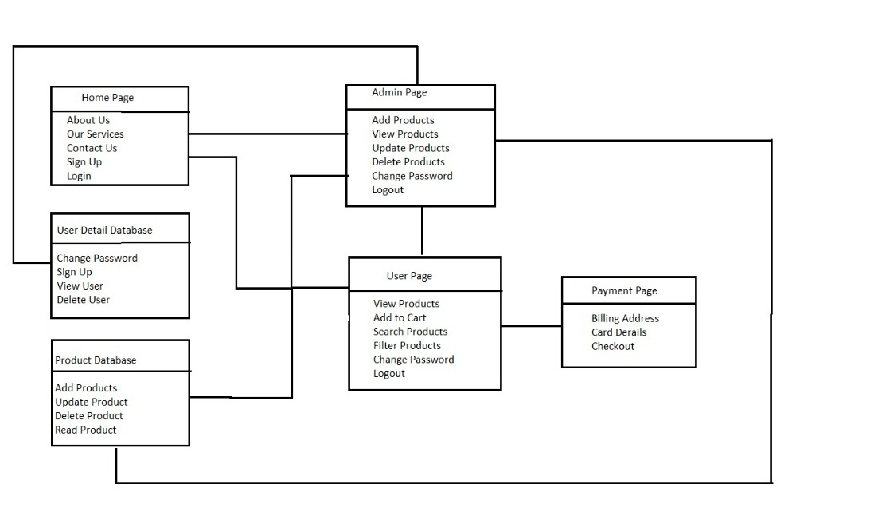
Data Flow

Slide 9
Modules
Home Page
User Registration
Admin and User Login
Admin Dashboard
Add Product
View and Update Product
User Dashboard
Add Medicine to Cart
Check Out and Payment

Slide 10
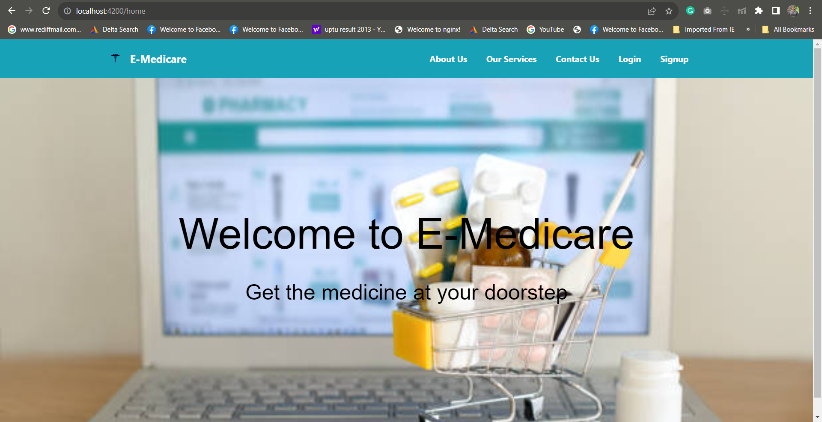
Home Page

Slide 11
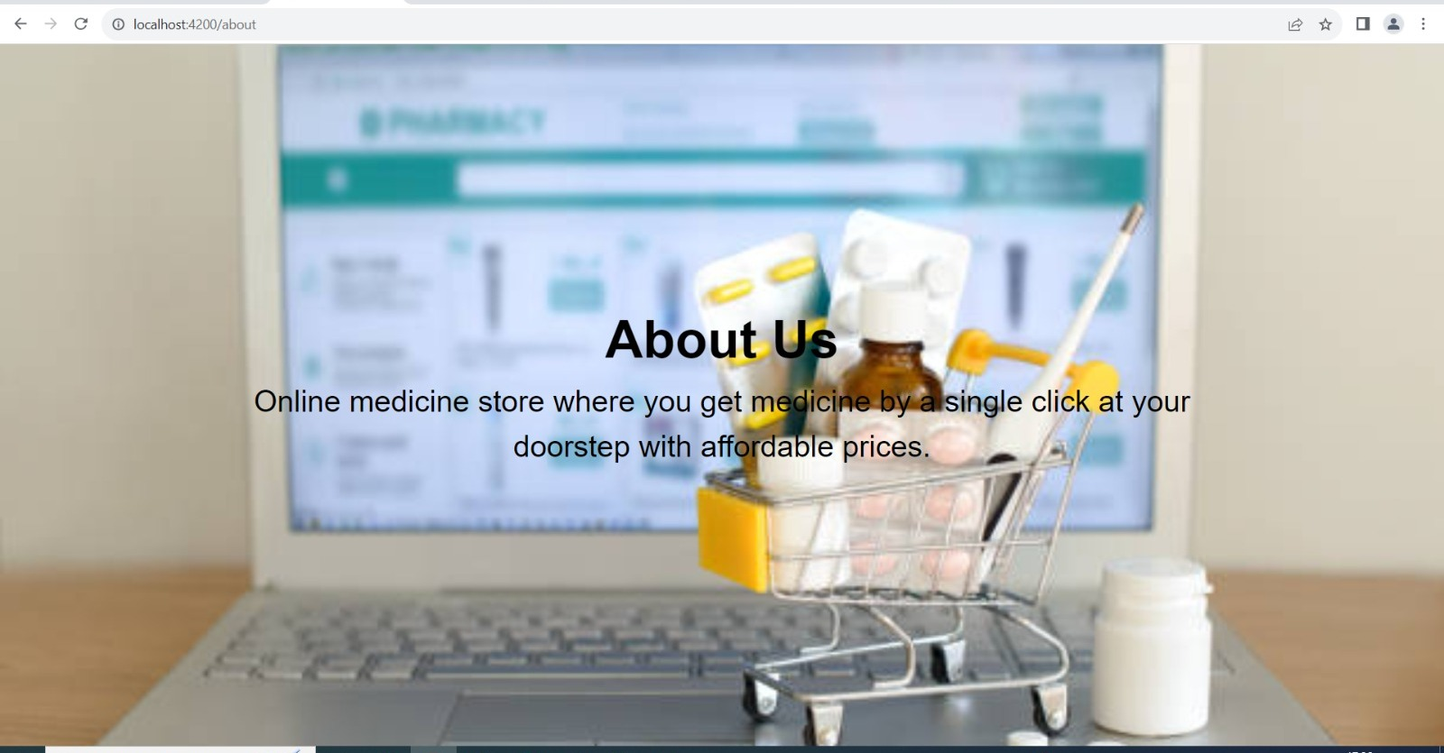

Slide 12
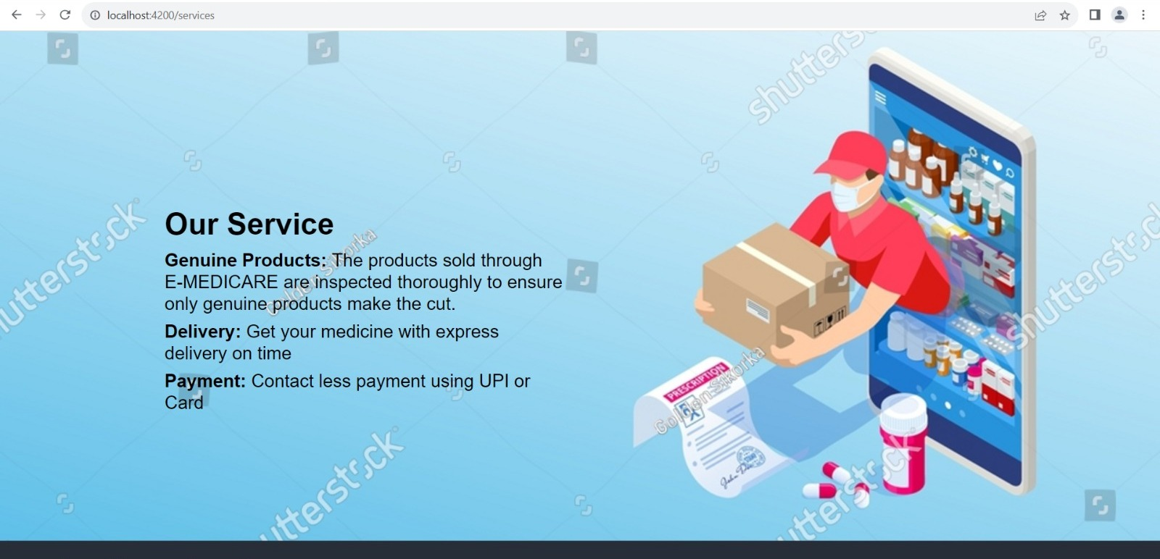

Slide 13
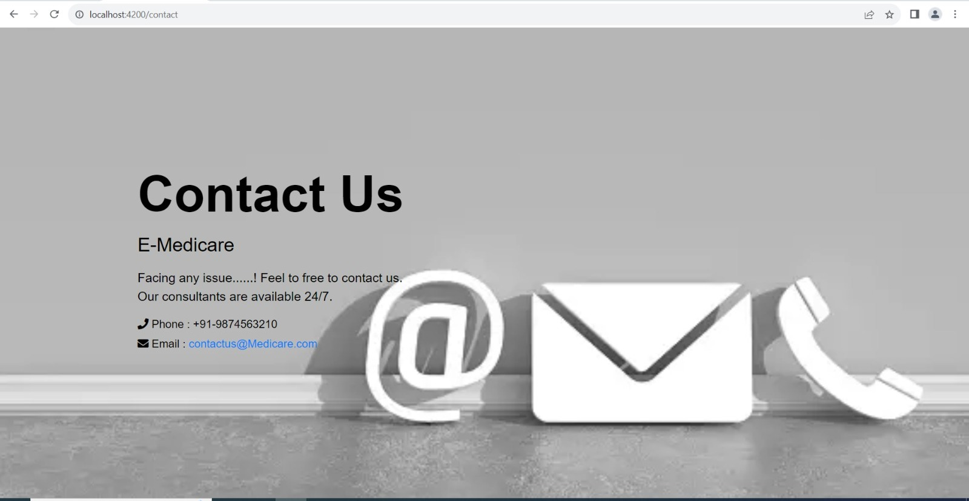

Slide 14
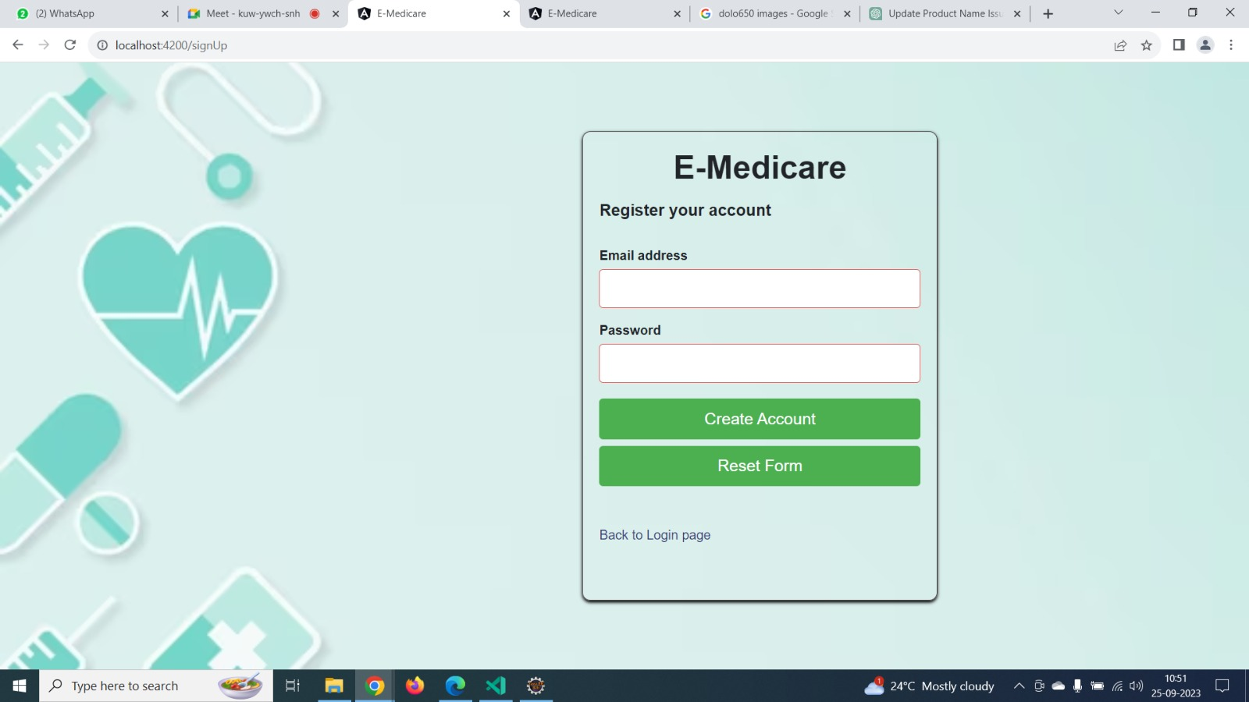
User Registration
New user can register by giving their email and assigning a password.

Slide 15
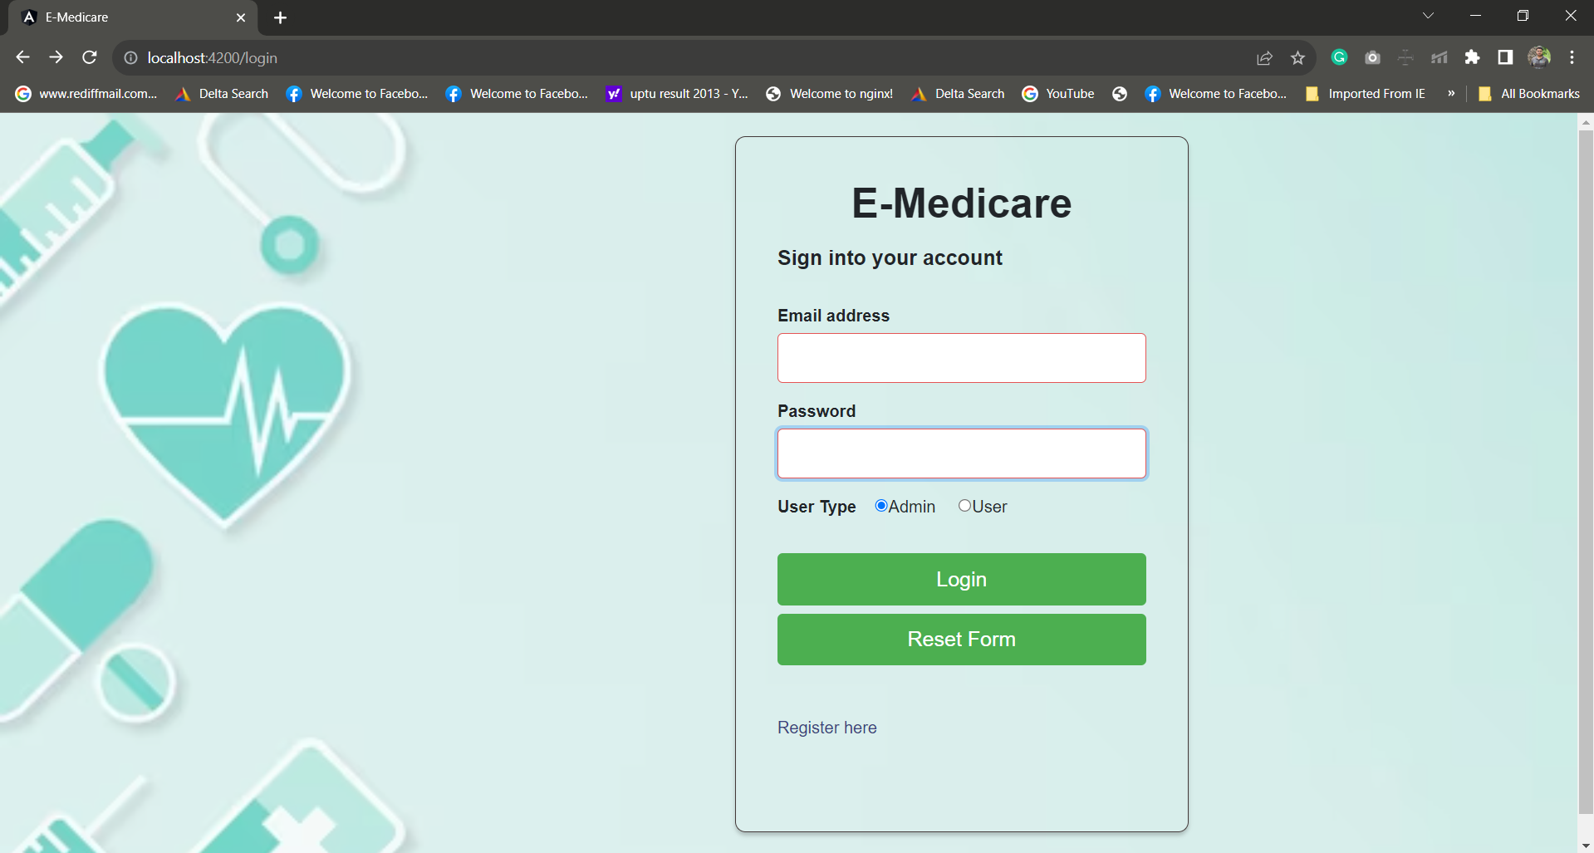
Admin Login
Authorized admin can only Login to admin portal.

Slide 16
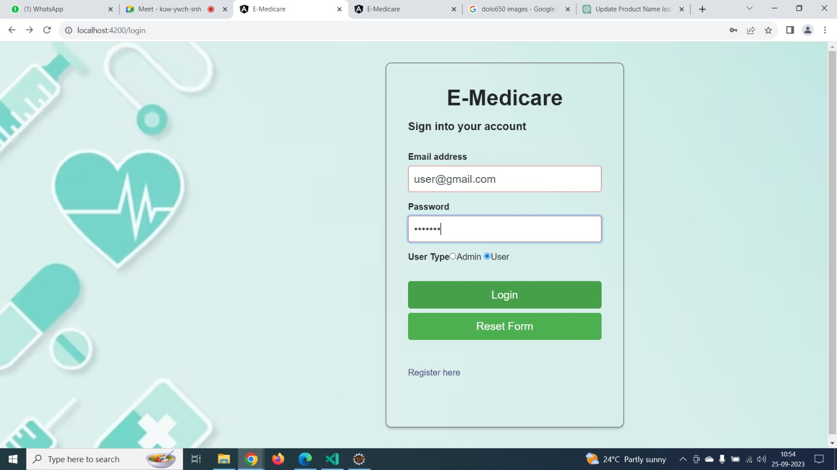
User Login
User can login with their Login credentials given at the time of registration.

Slide 17
Admin
Admin can signin using the login credentials saved in the database.
Admin can add products, delete the products.
The details of medicine can be updated by the admin.
Admin can find the customer details.

Slide 18
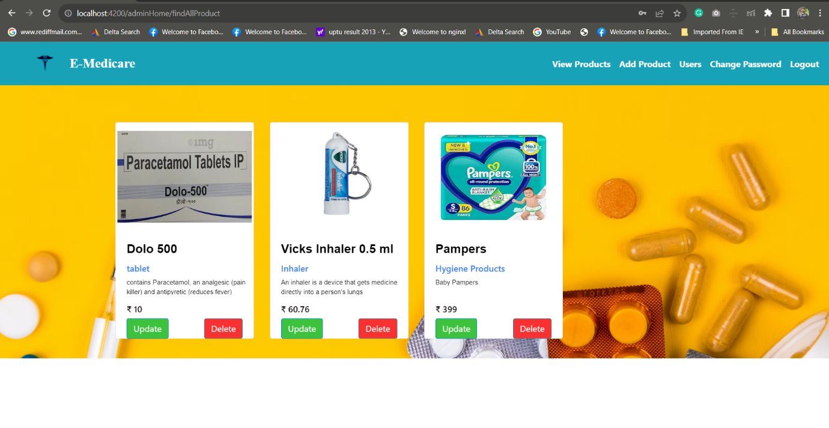
Admin Dashboard

Slide 19
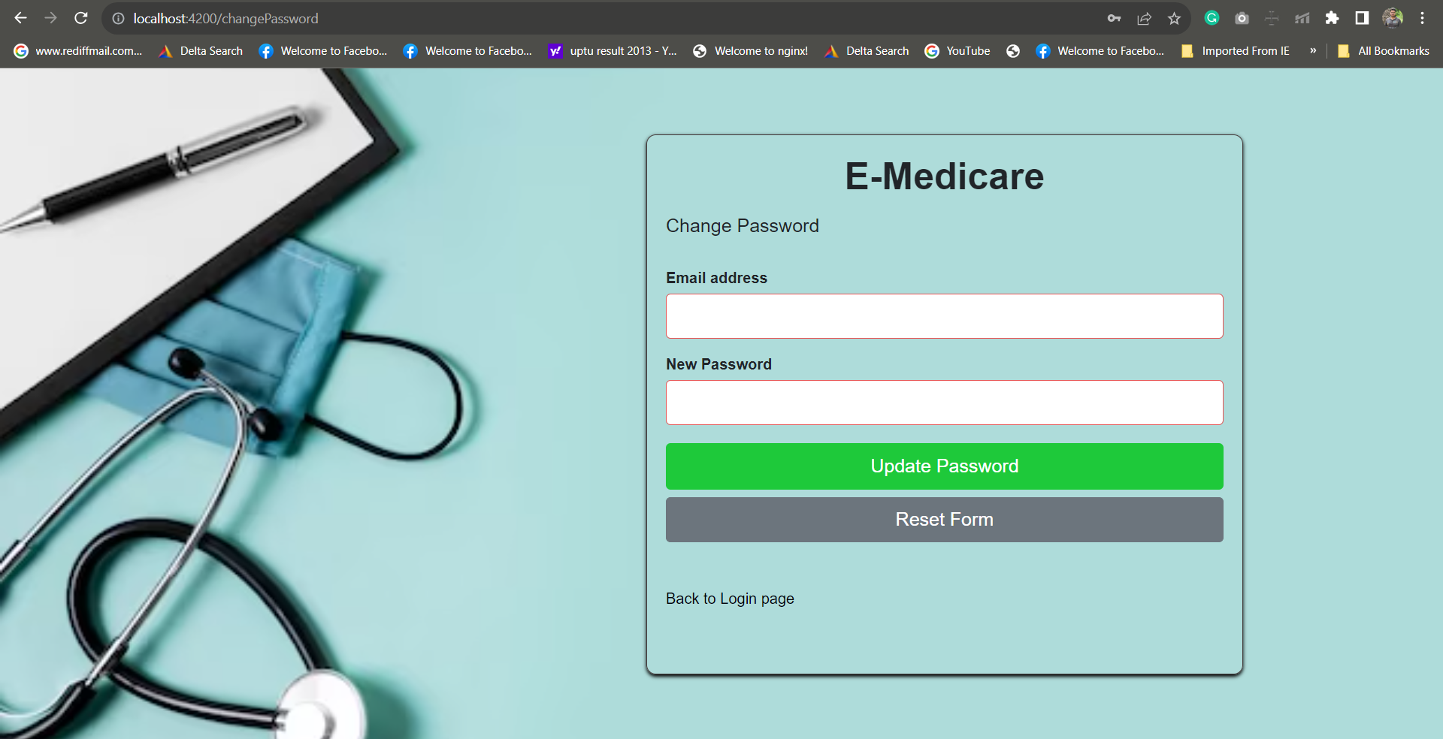
Change password

Slide 20
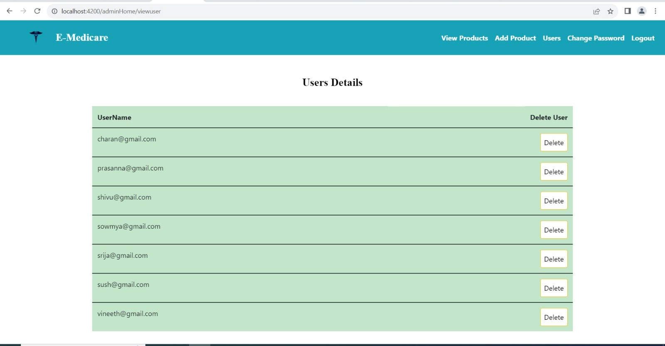
View user
Admin can view user details and can also delete the user.

Slide 21
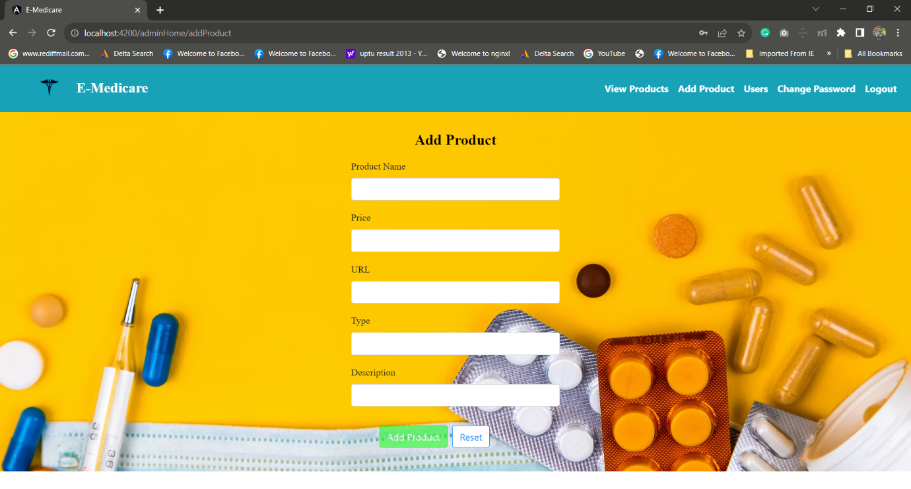
Add Product
Admin can add new products in all different categories.

Slide 22
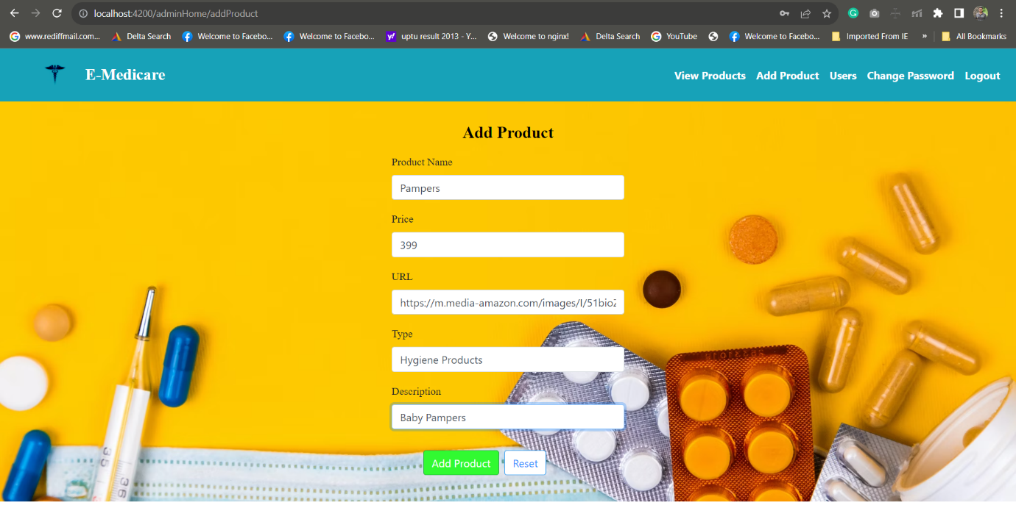

Slide 23
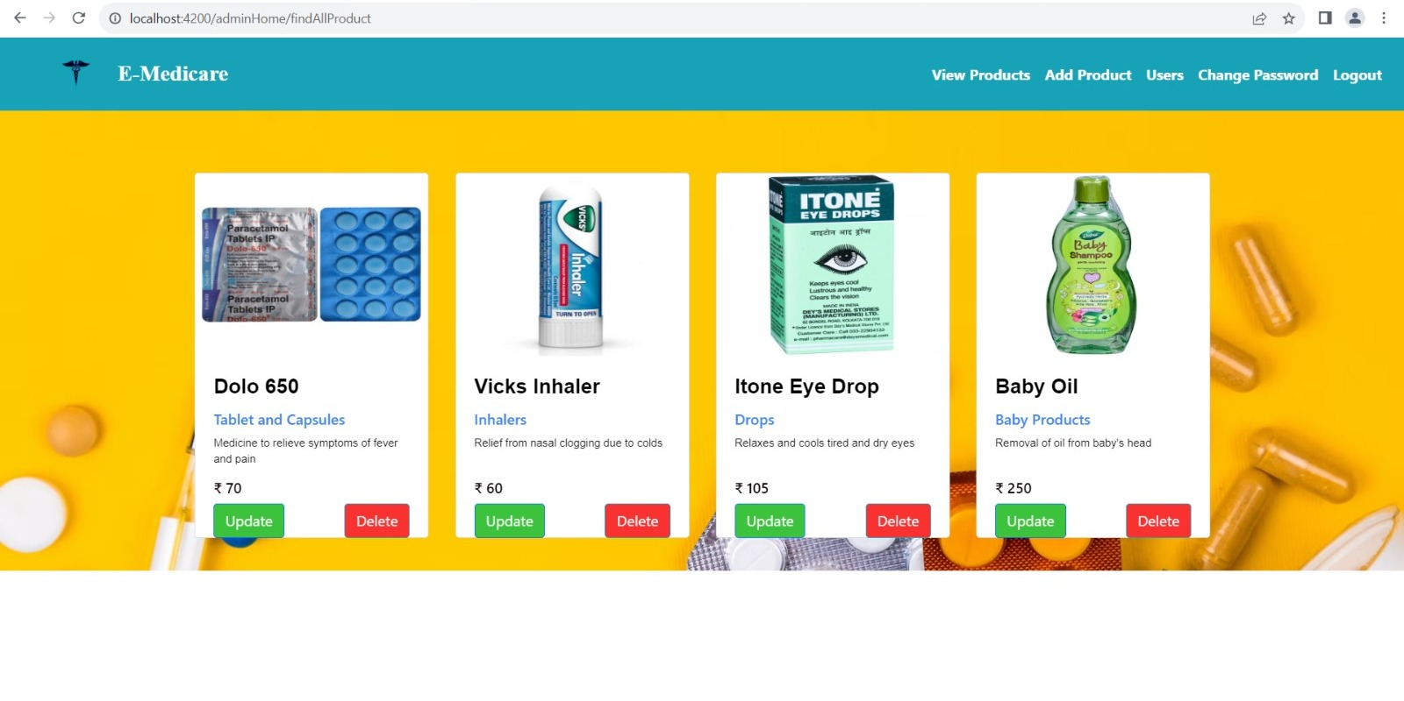
View Product
Admin can view all the Products to check the description and update if needed.

Slide 24
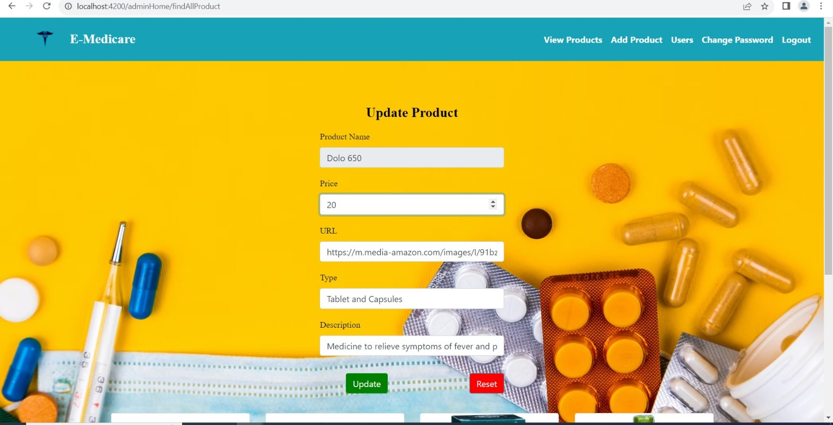
Update Product
Admin can update the product details.

Slide 25
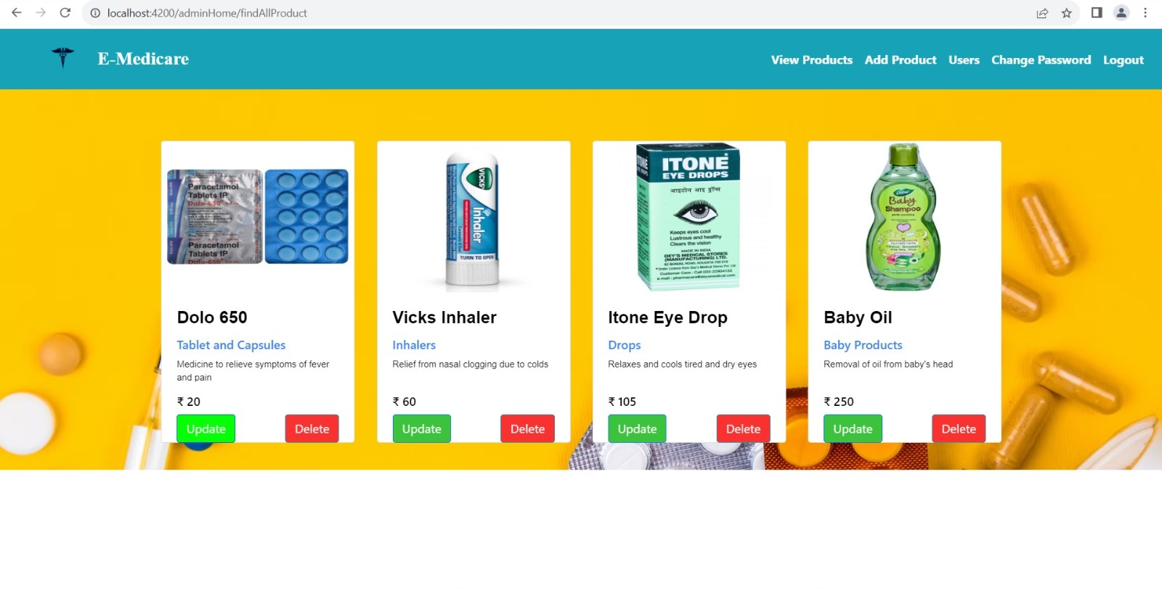
After updating the product

Slide 26
User
New user can register into the application and get logged in.
User can search the products using product name.
For more convenience user can select category of the product.
Add the products into the cart.

Slide 27
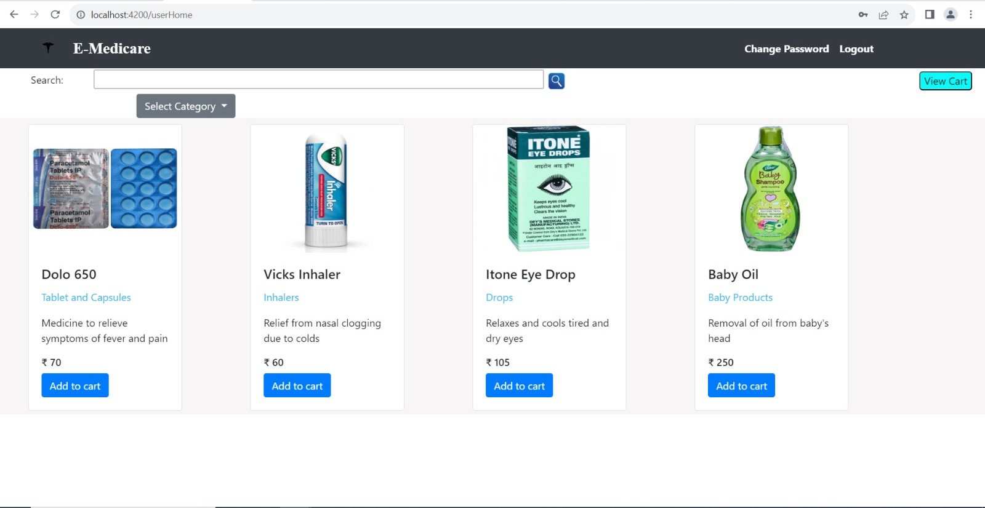
User Dashboard

Slide 28
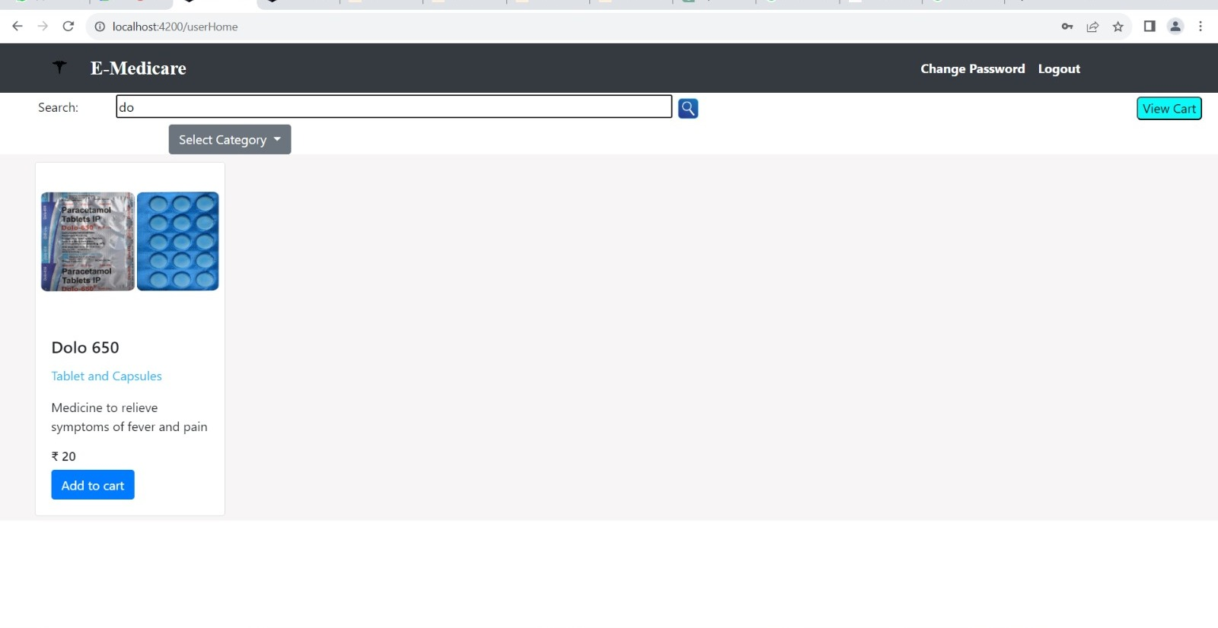

Slide 29
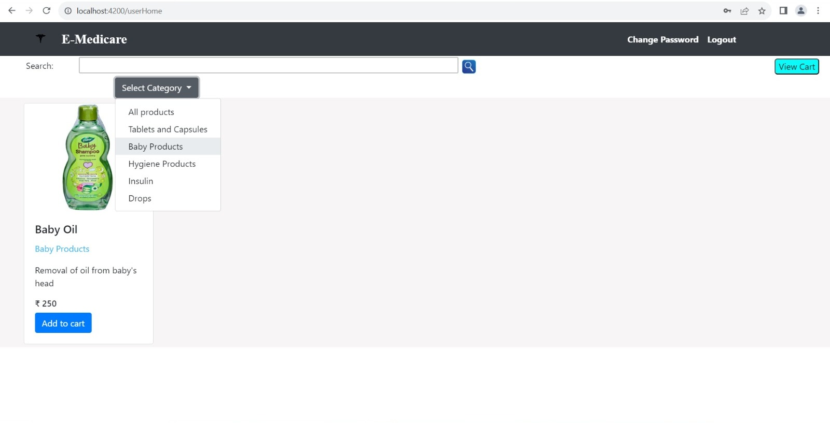

Slide 30
User Cart
Cart displays all the medicine added by the user/customer.
It shows the quantity of medicine added.
The total amount to be paid is calculated and shown clearly to the customers.

Slide 31
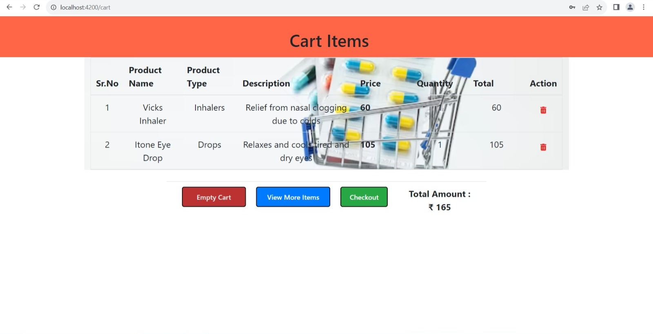
View Cart

Slide 32
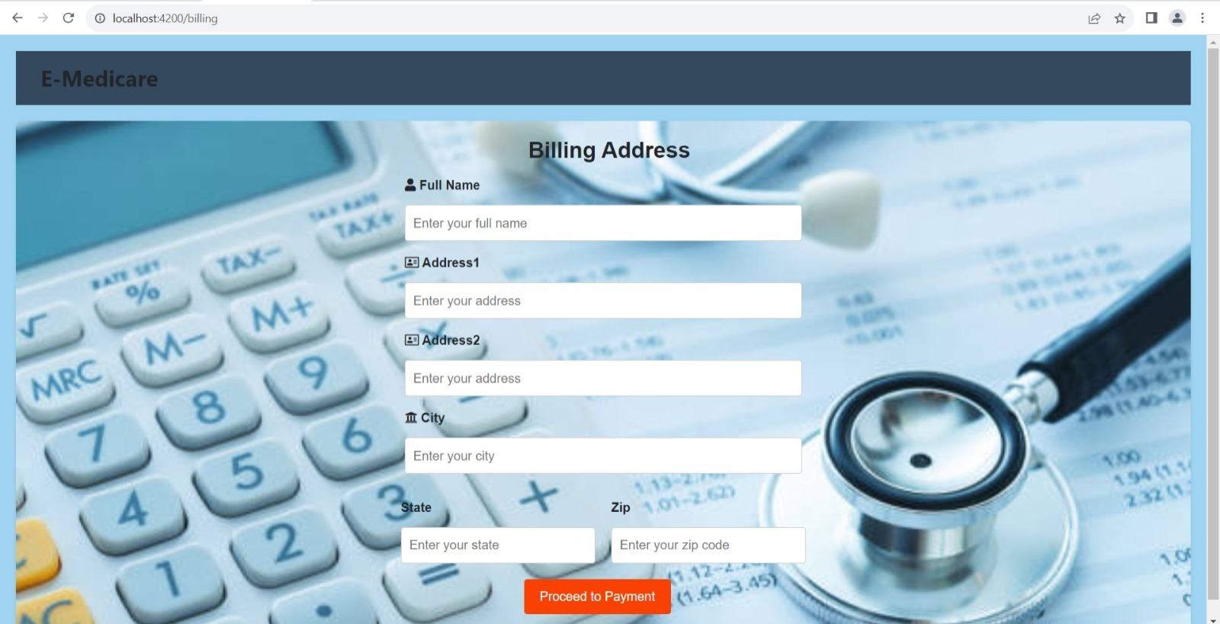
Billing address

Slide 33
Payment
Used for managing the details of payment.
User can continue the payment process by adding the card details.
Contactless Payment procedure.

Slide 34
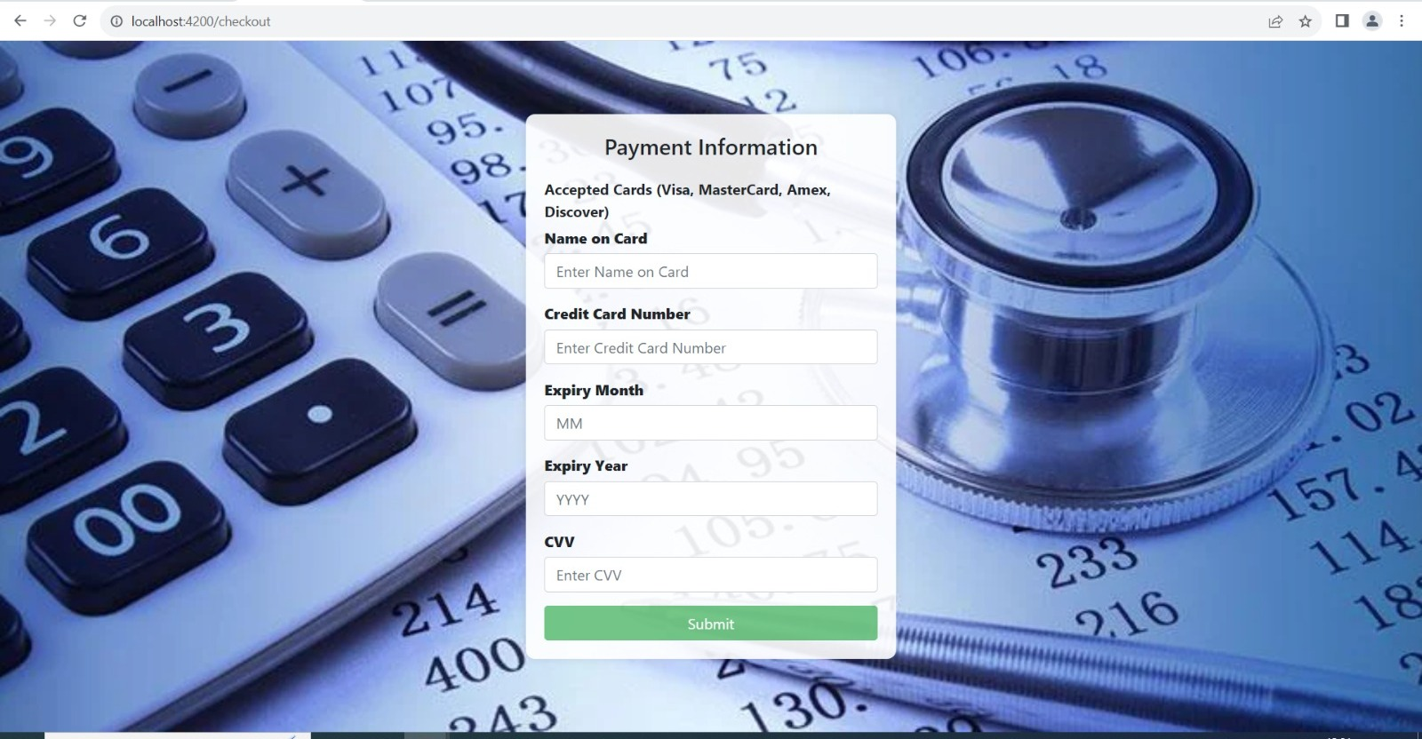
Payment Details

Slide 35
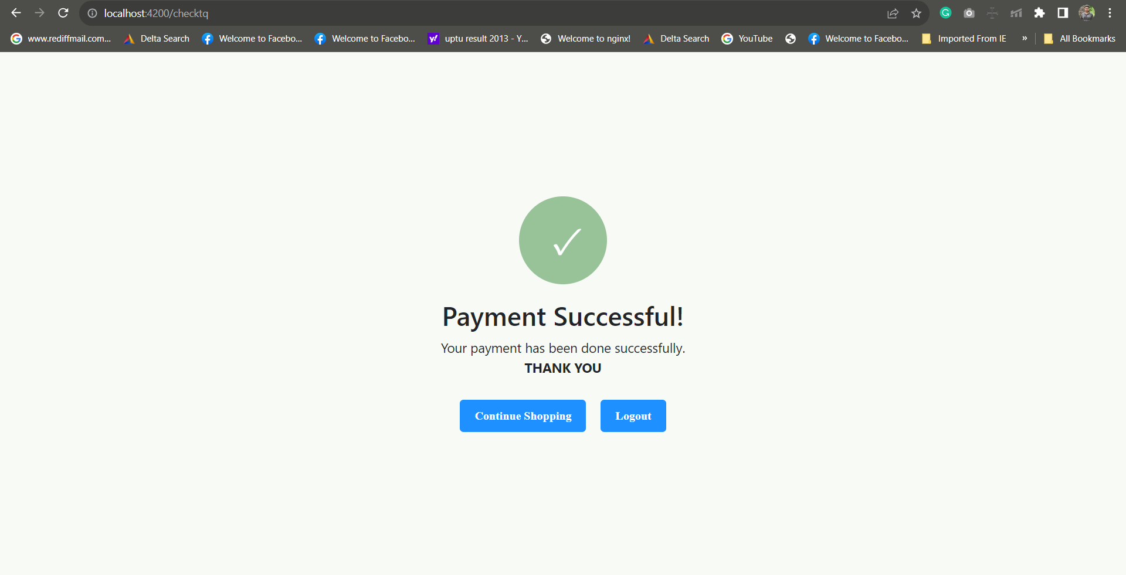

Slide 36
Advantages
It is very easy to order prescription medicine through E-Medicare. Especially for people who live far away from a Local pharmacy.
One of the most important advantages of the E-Medicare application is time saving.
You can order your medication within minutes and get your prescription medicines very quickly.

Slide 37
Postman testing
Postman is one of the most popular software testing tools which is used for API testing.
This tool has the ability to make various types of HTTP requests like GET, POST, PUT, PATCH.

Slide 38
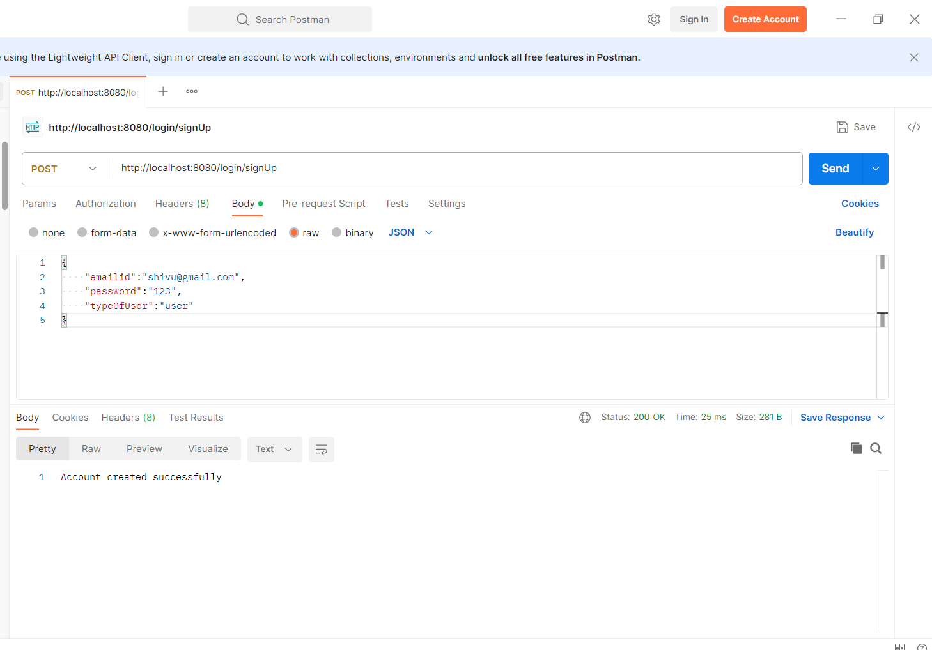
Postman Testing
Signup or Signin

Slide 39
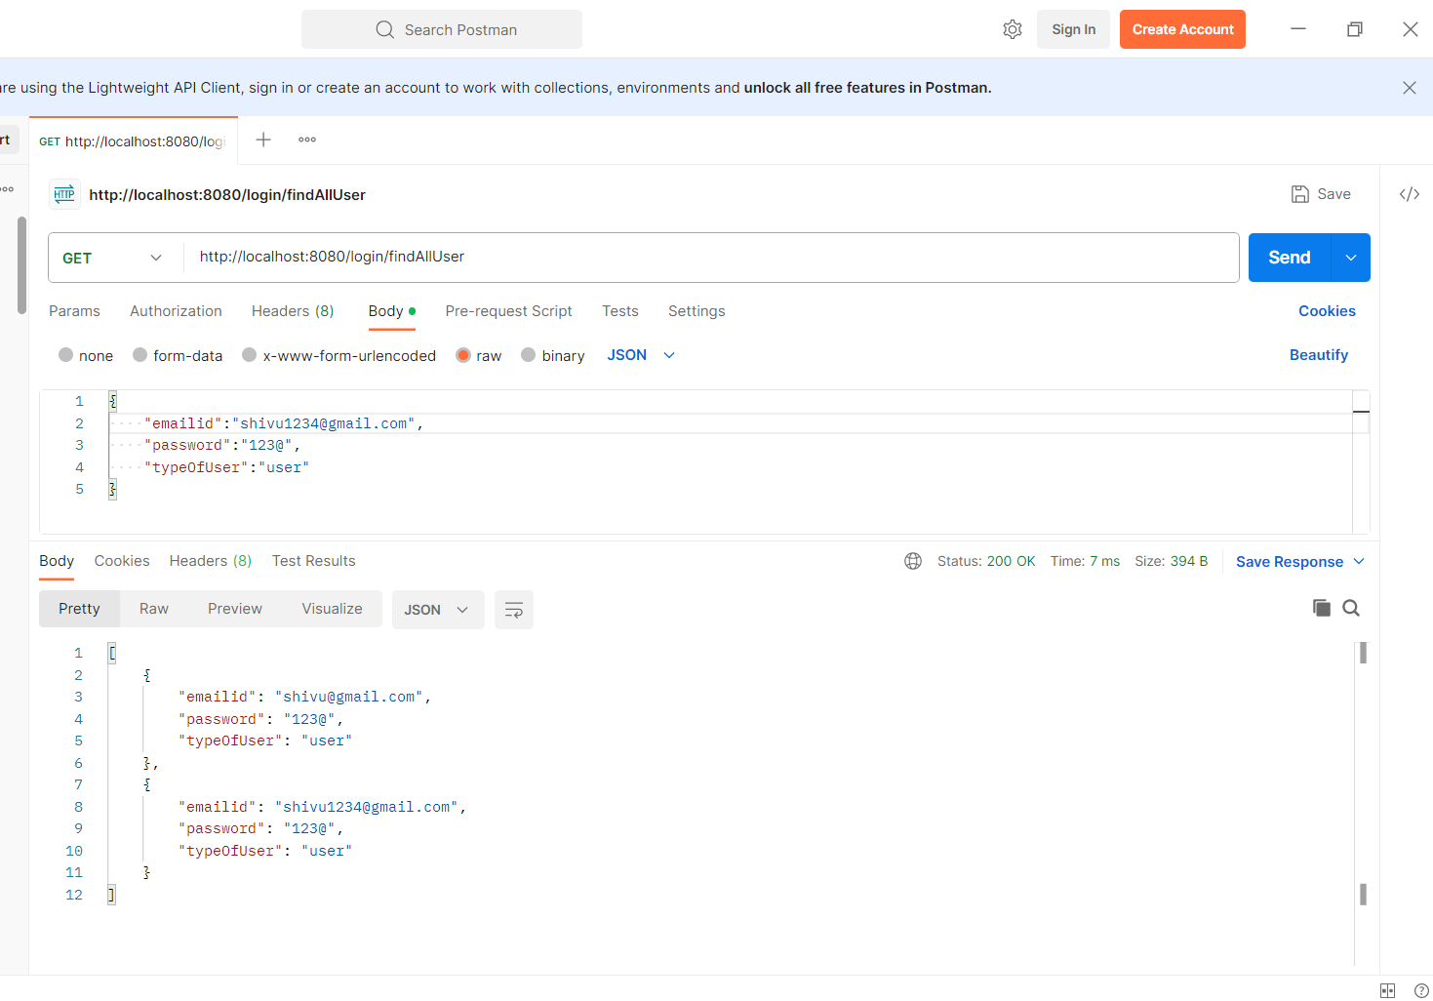
Find all users

Slide 40
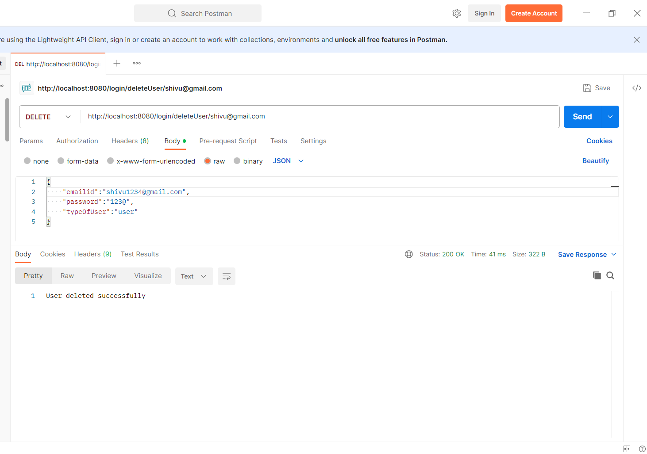
Delete User

Slide 41
Conclusion
The E-Medicare web application help users in purchasing the medicine and other health products.
This application is user friendly.
Any user can buy the products at any time and get them delivered.

Slide 42


